Slide 1
Ismart AA tracking requirements
Secretary/Agent Access
May 2022

Slide 2
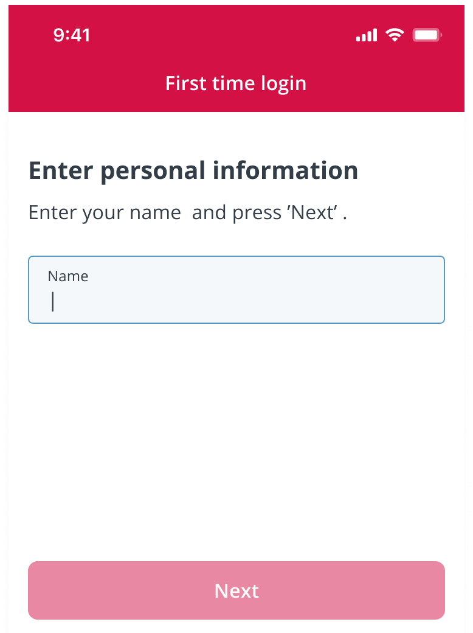
Secretary – First Time Login (Request Access From)

Slide 3
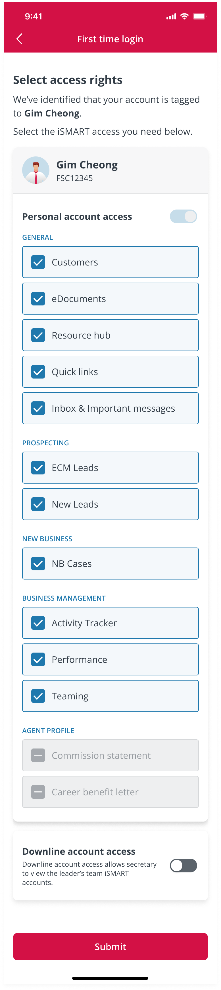
Secretary – Select Access Rights

Slide 4
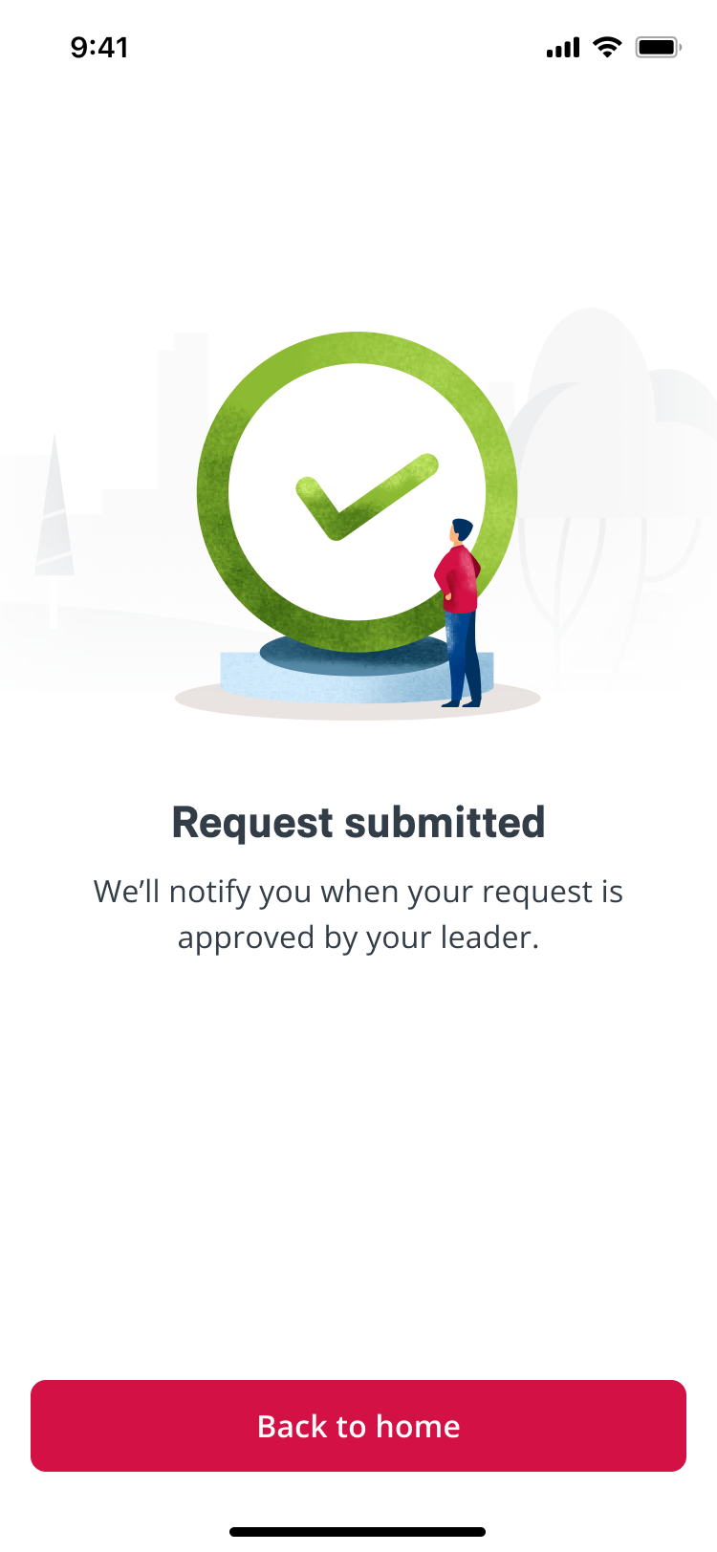
Secretary – Request Submitted

Slide 5
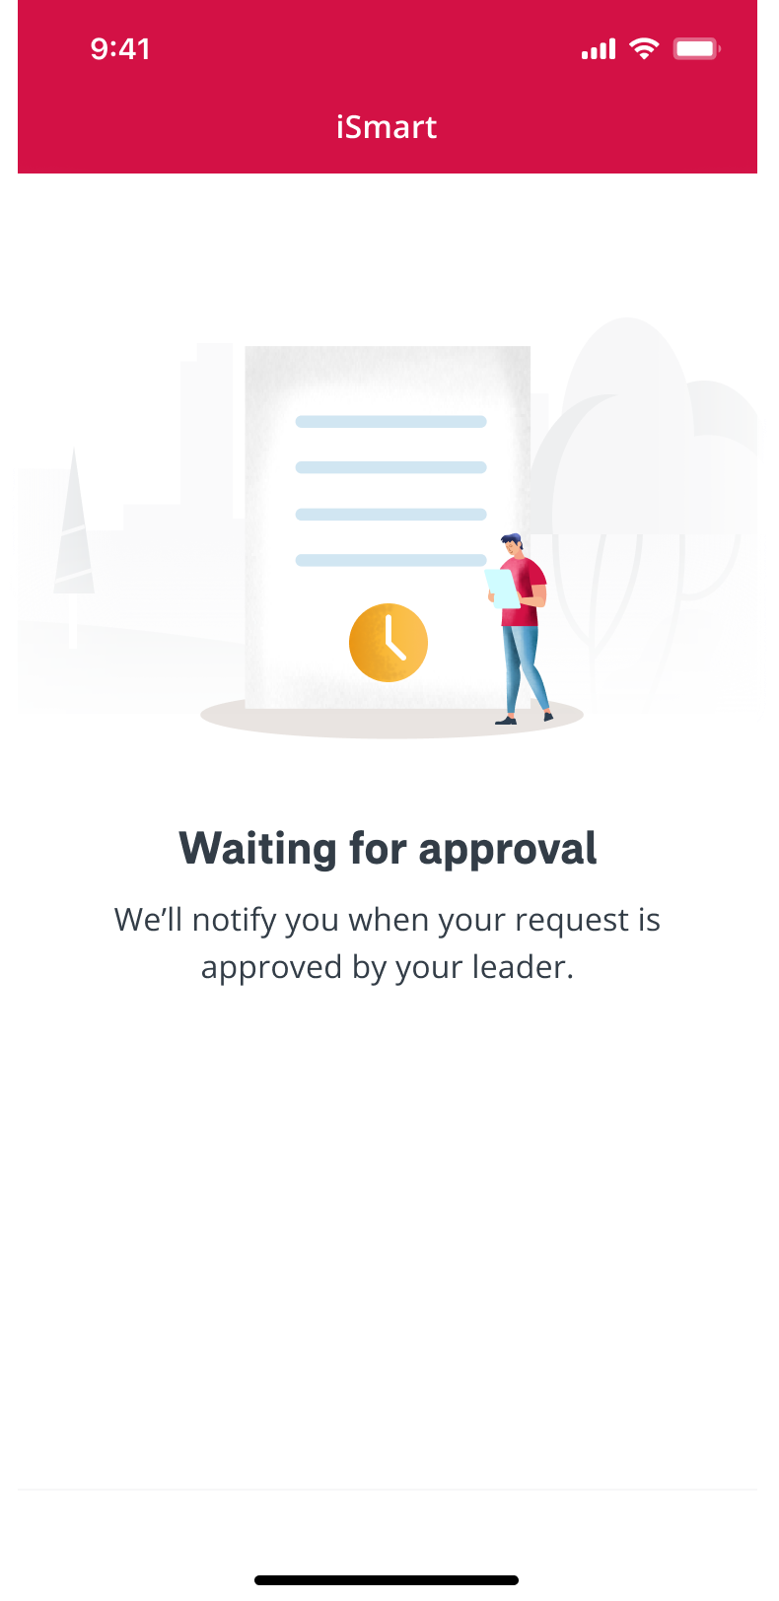
Secretary – Waiting for Approval

Slide 6

Secretary – Notification Inbox

Slide 7
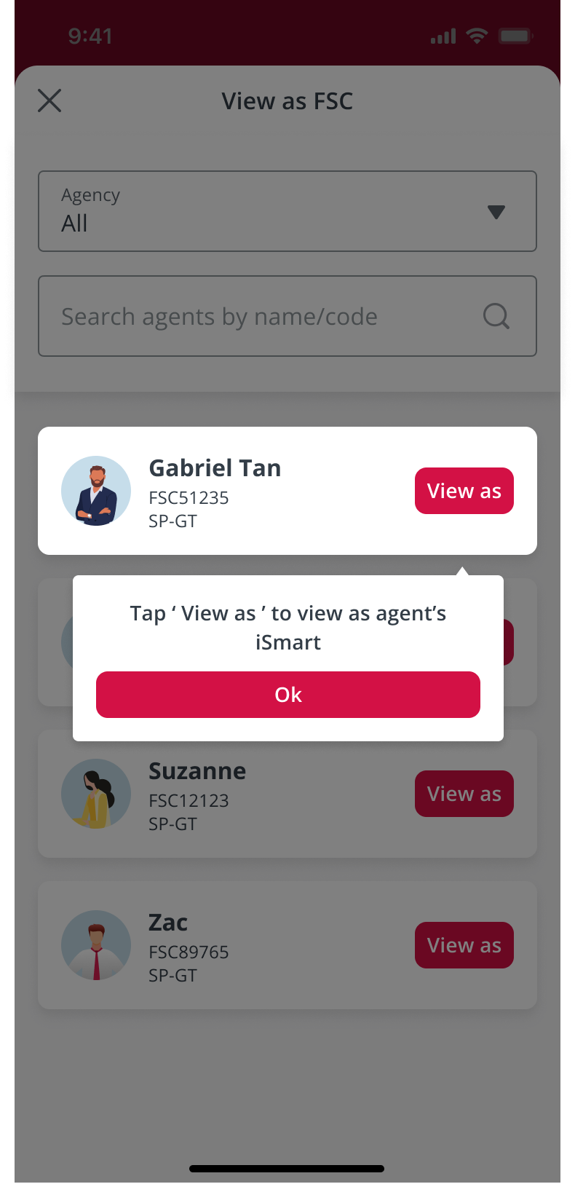
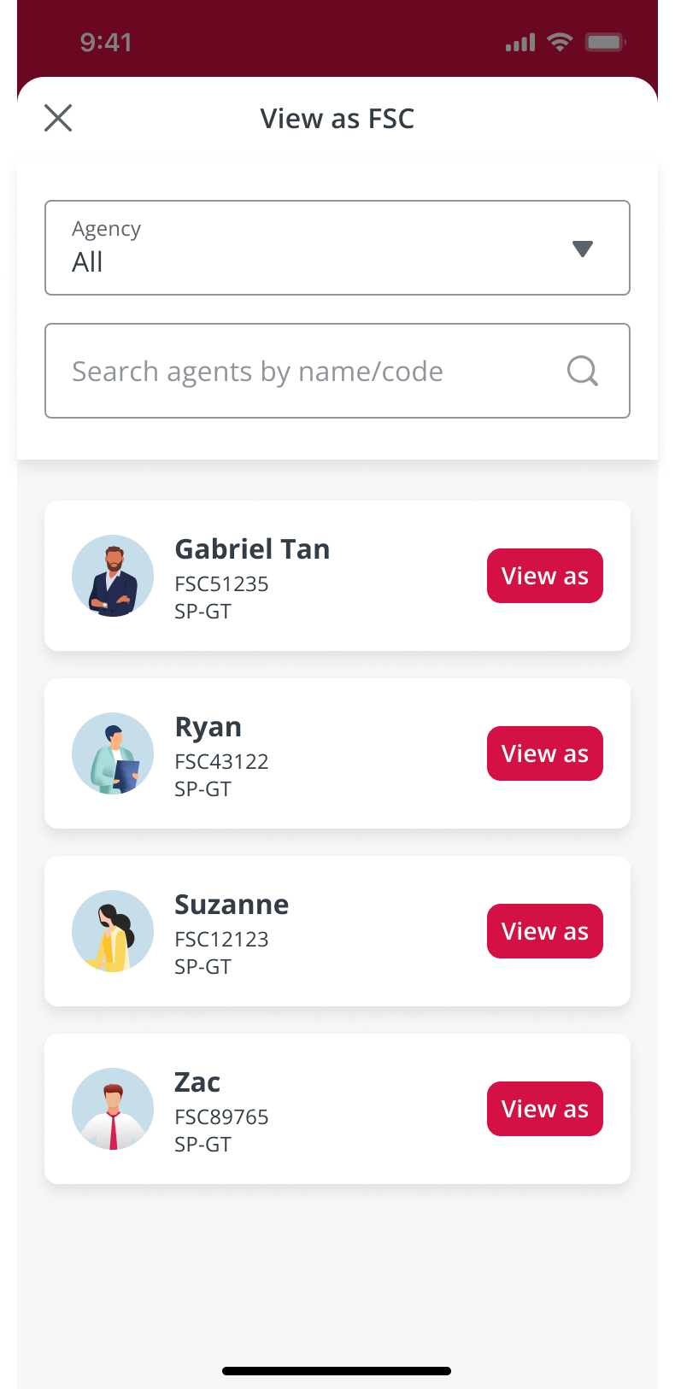
Secretary – View as FSC drawer (appear every time when secretary login)
Go to slide 10
Go to slide 8

Slide 8
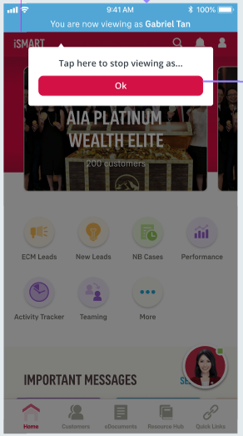

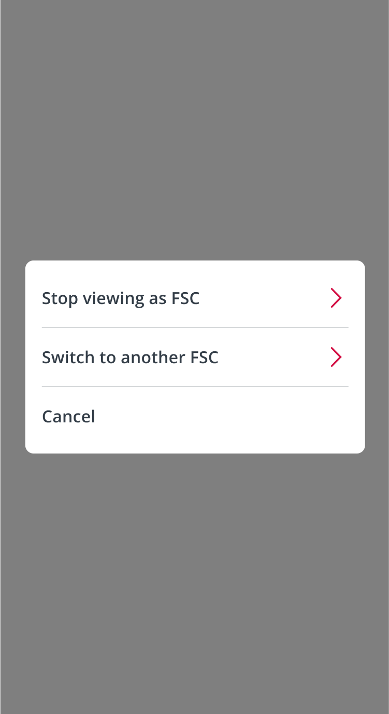
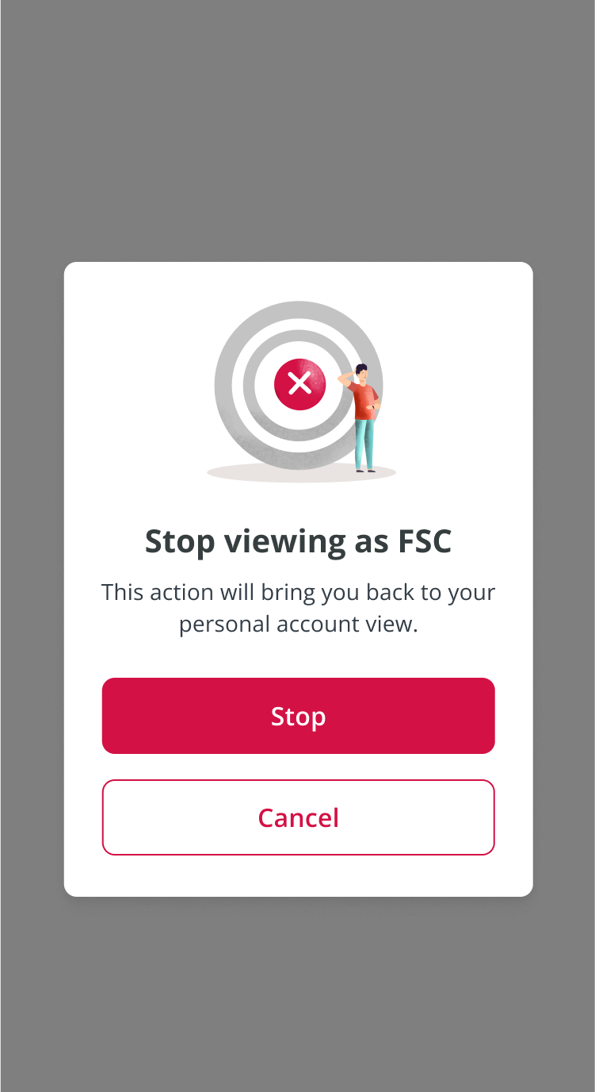
Secretary – Switch/Stop Viewing as FSC
Screen Not Available
Go to slide 9

Slide 9
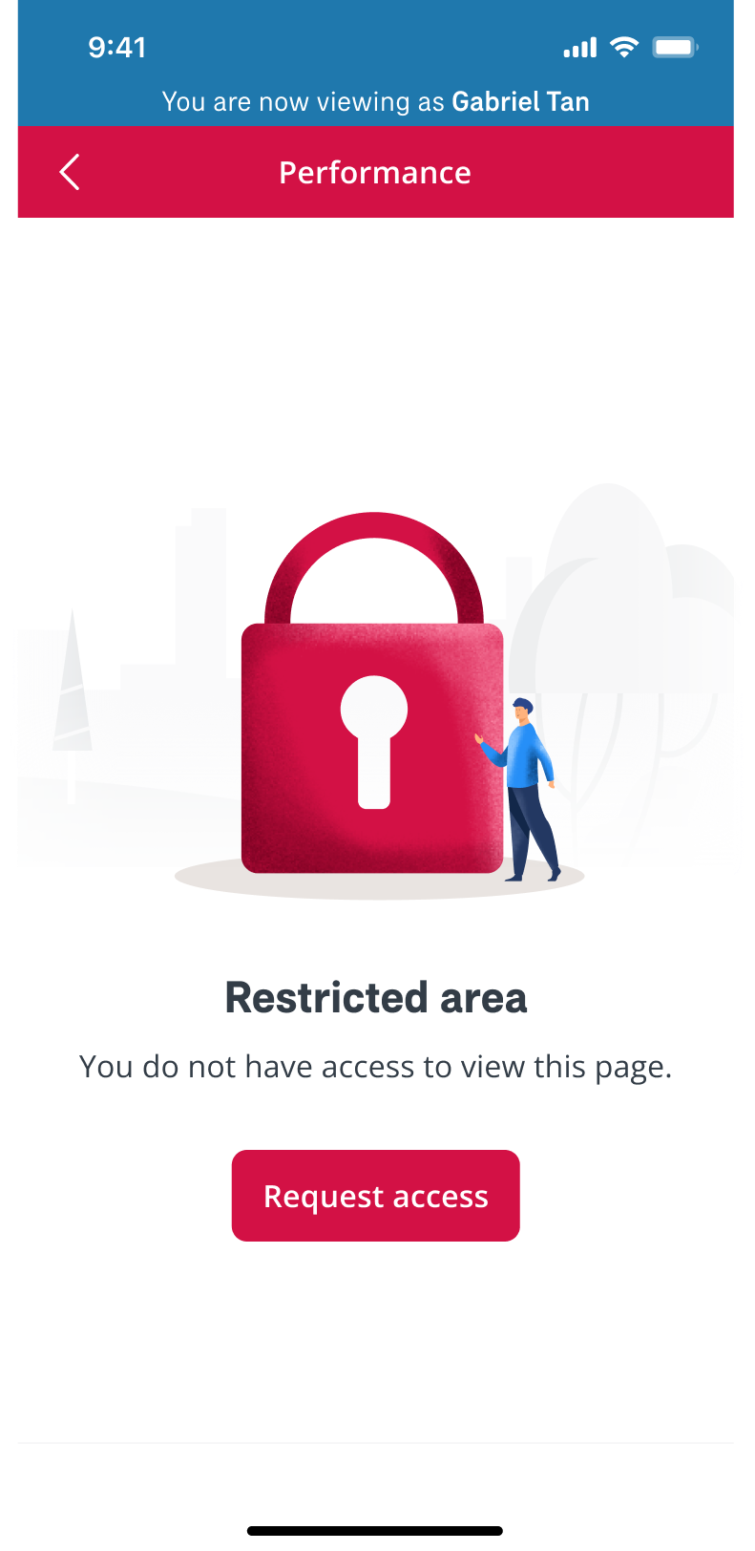
Secretary Access – Restricted Area

Slide 10
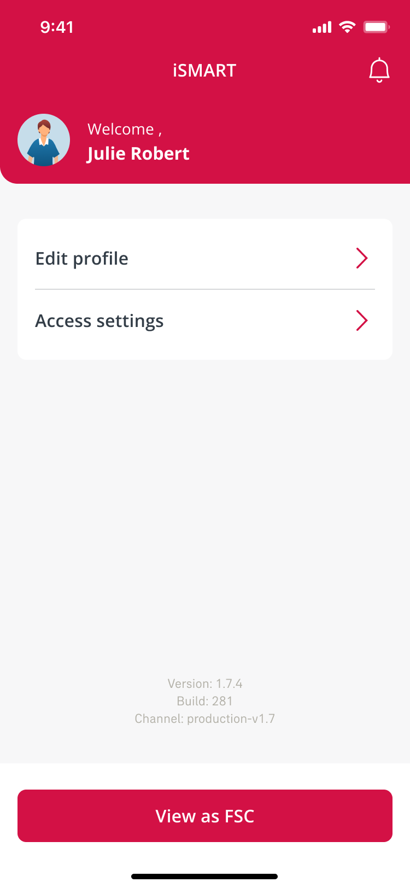
Secretary – Profile

Slide 11
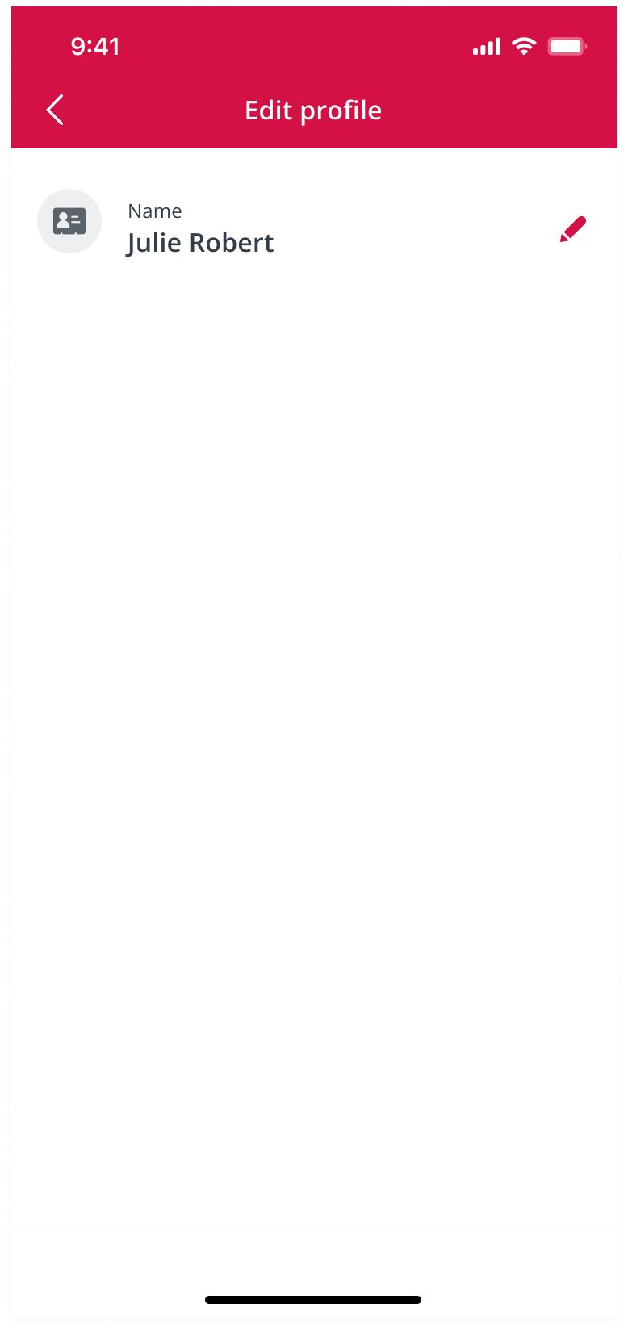
Secretary – Account Settings (Edit Profile)

Slide 12
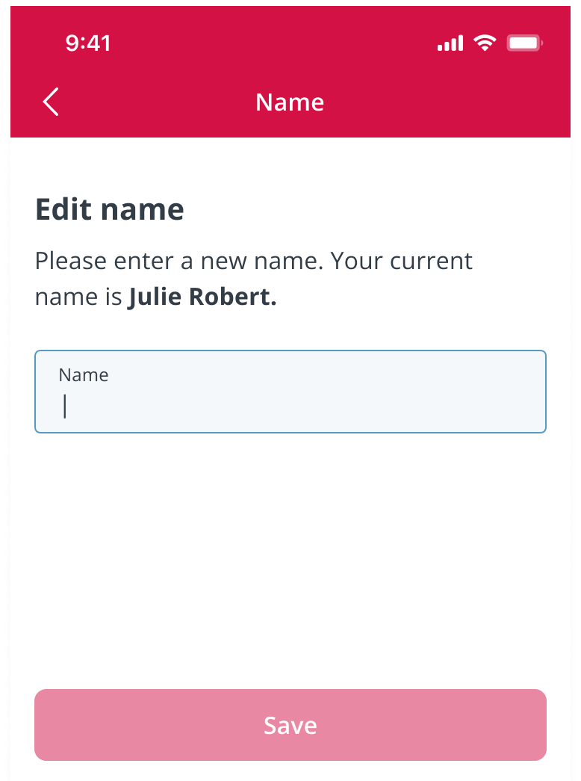
Secretary – Edit Name

Slide 13
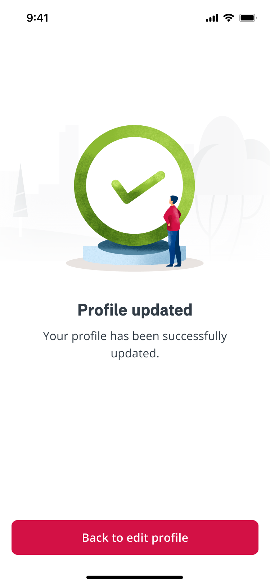
Secretary – Updated Successfully

Slide 14
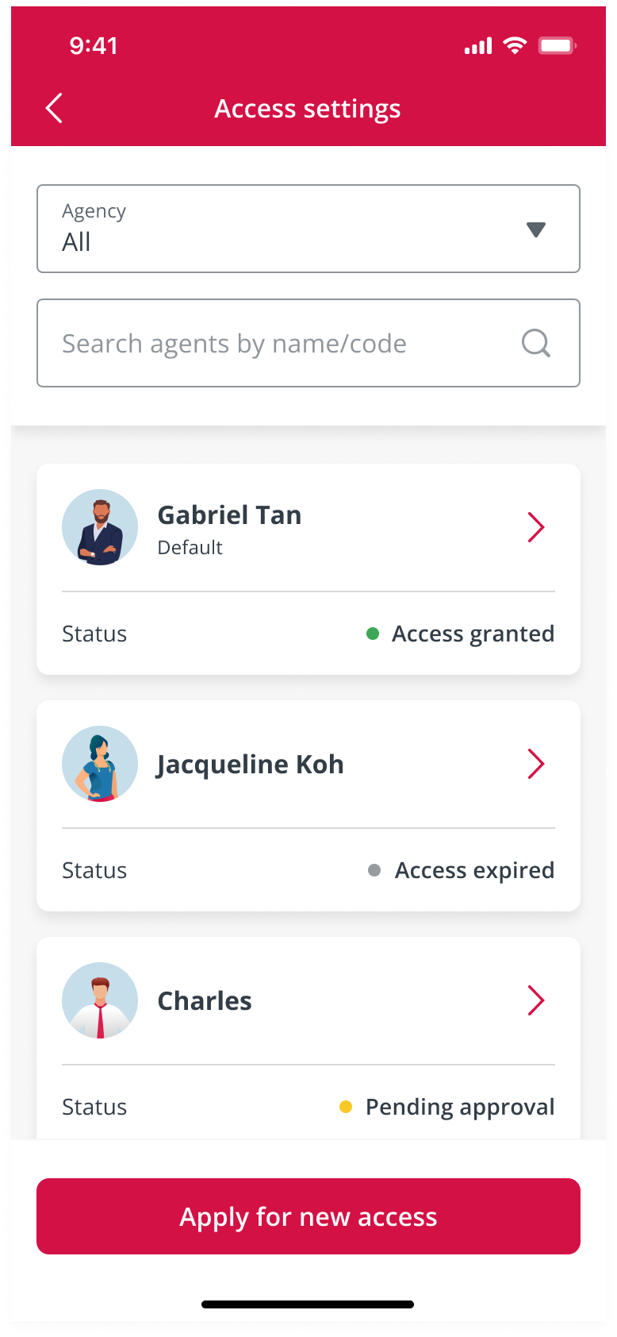
Secretary – Access Settings
Go to slide 15
Go to slide 15
Go to slide 17
Go to slide 18

Slide 15
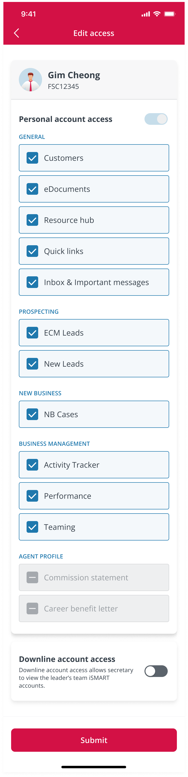
Secretary – Edit Access

Slide 16
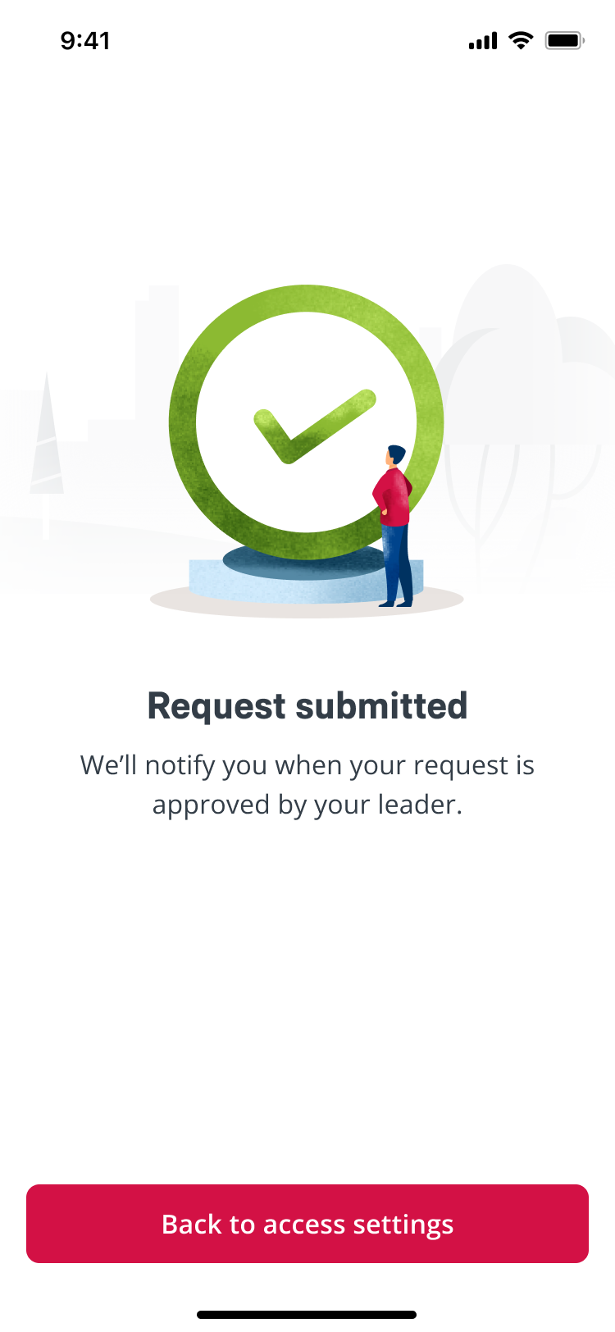
Secretary – Request Submitted

Slide 17
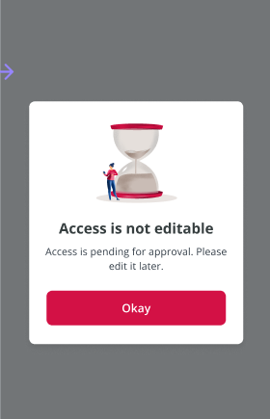
Secretary – Access is not editable

Slide 18
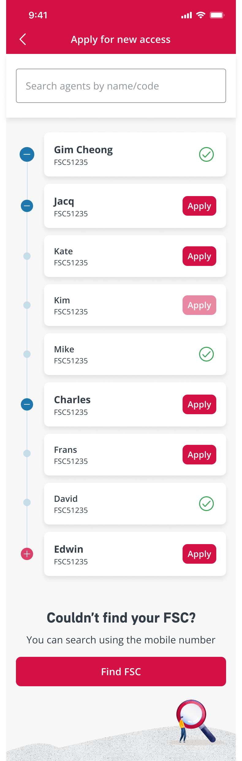
Secretary – Apply for New Access
Feature unavailable

Slide 19
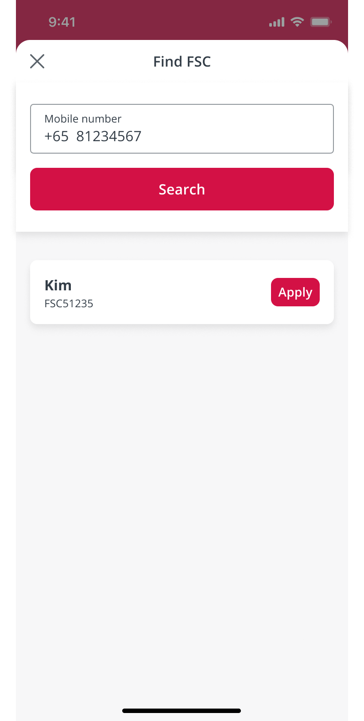
Secretary – Find FSC

Slide 20
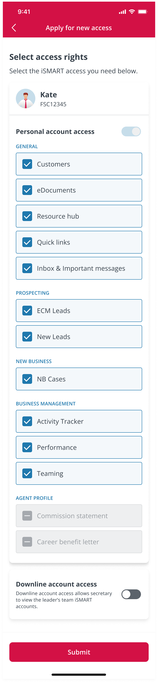
Secretary – Select Access Rights

Slide 21
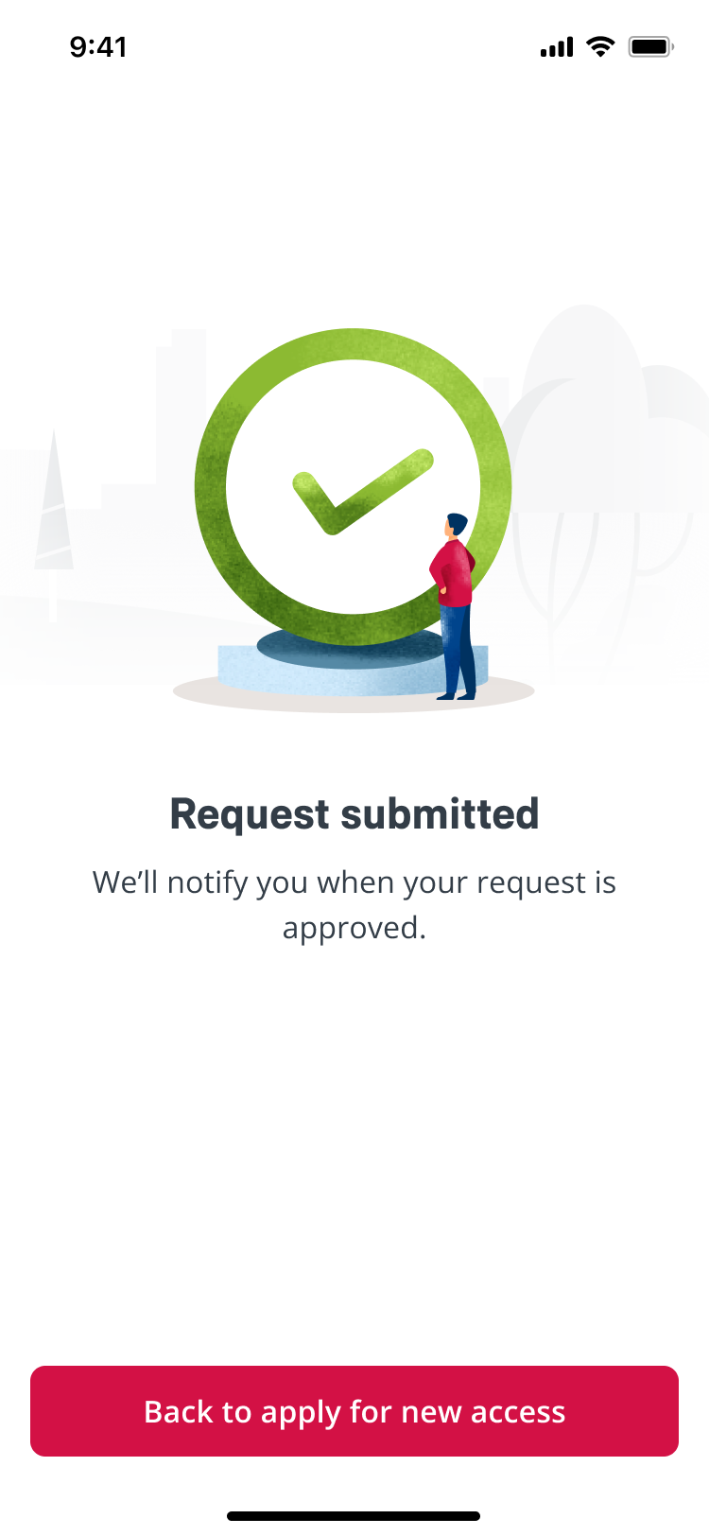
Secretary – Request Submitted

Slide 22
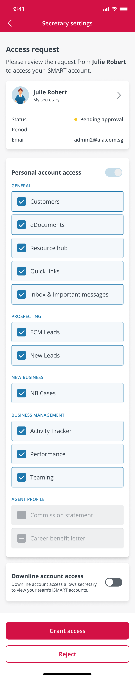
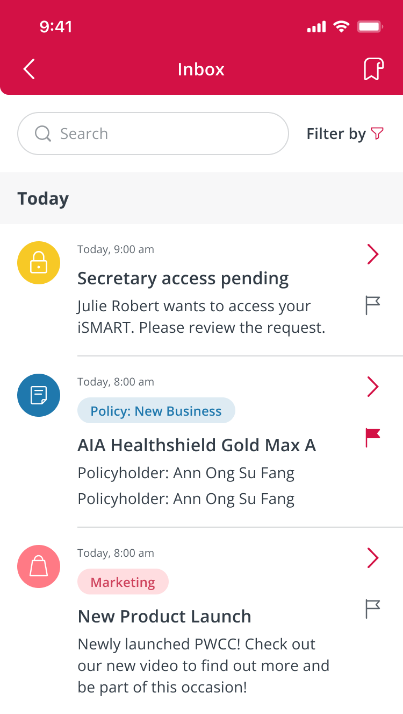
Agent – Secretary Settings

Slide 23
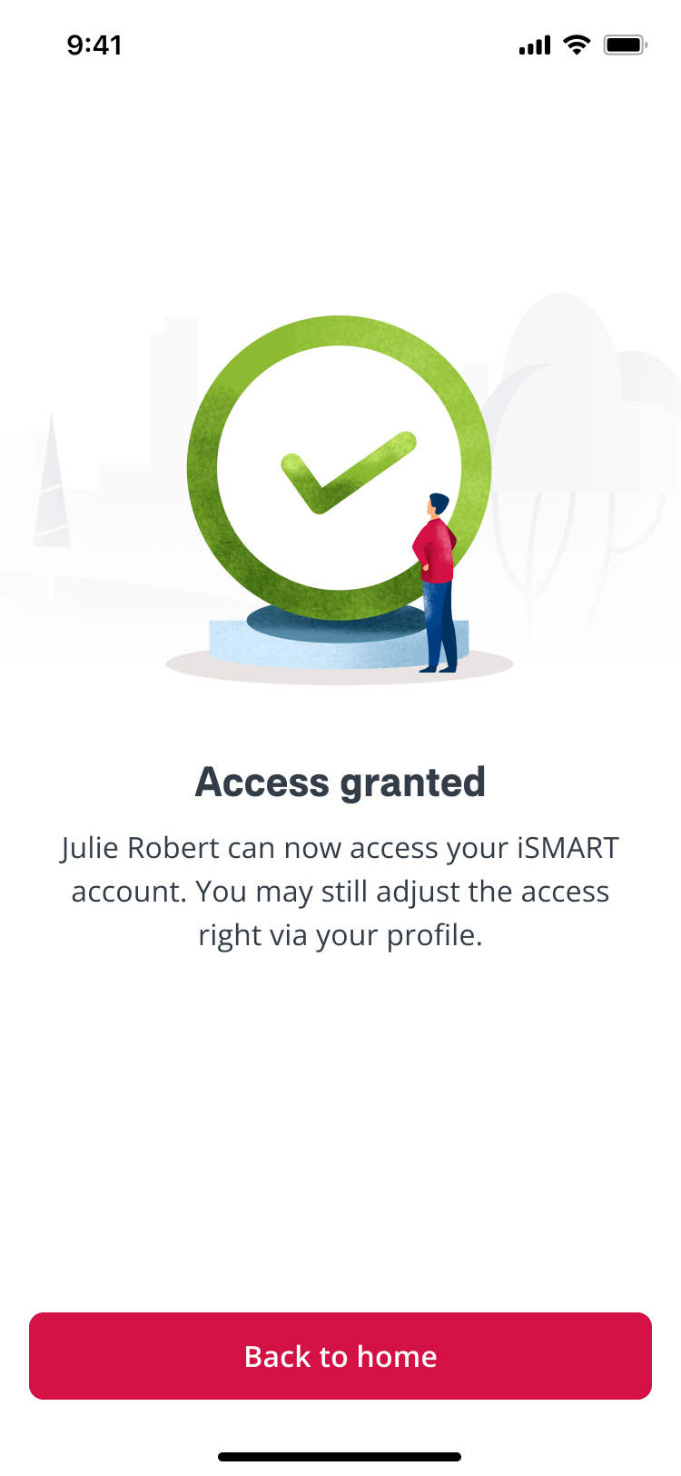
Agent – Access Granted

Slide 24
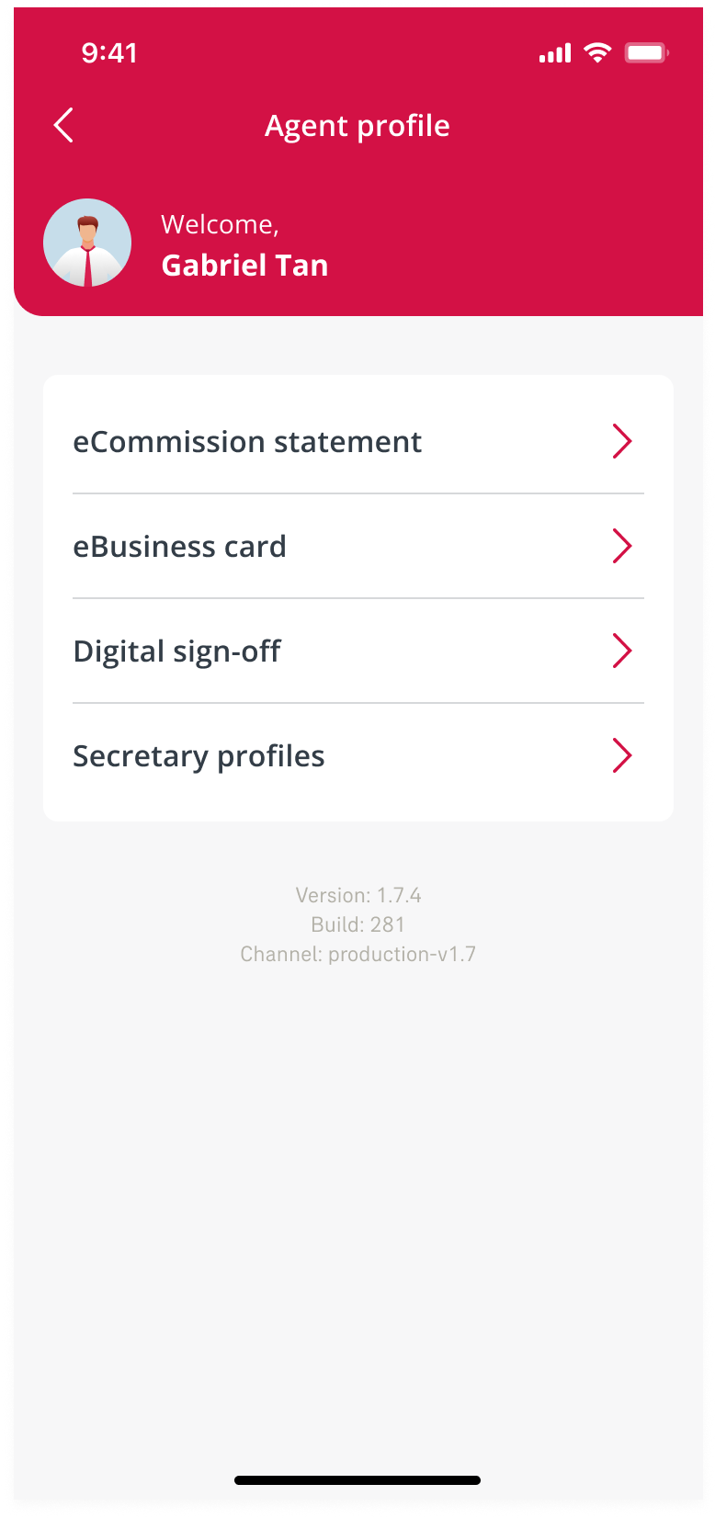
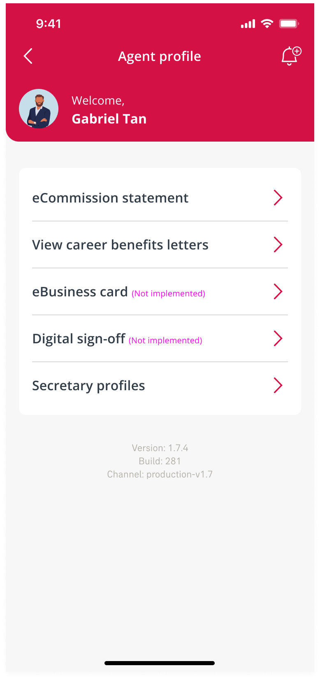
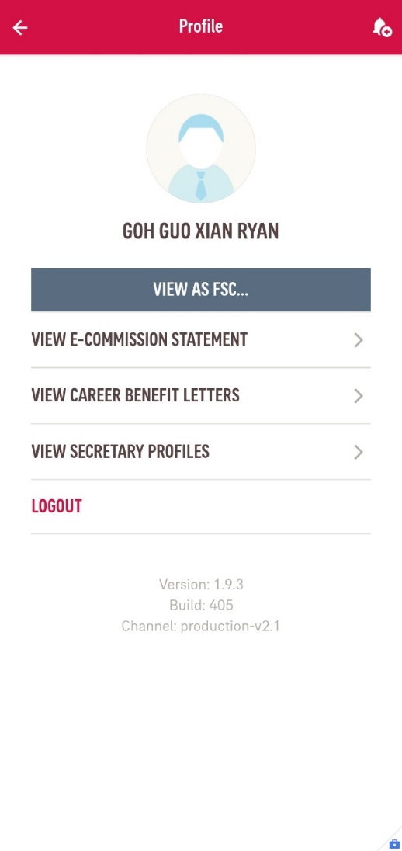

Agent/Staff – Profile
Go to slide 26
Staff is considered “agent” too as they are using FSC code to login, the only difference is Staff has “View As FSC” button
Not released
yet
Agent Access
Staff Access

Slide 25

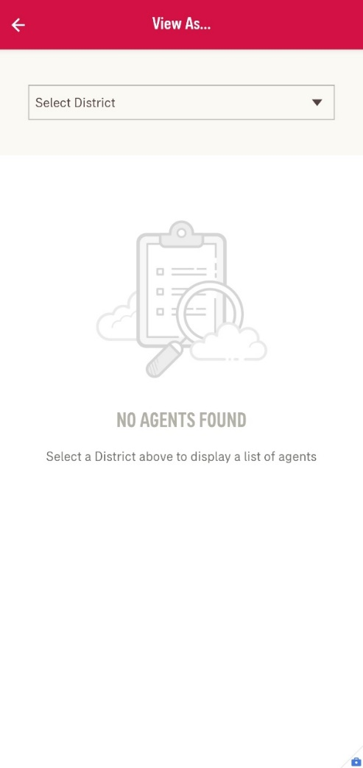
Staff – View As FSC

Slide 26

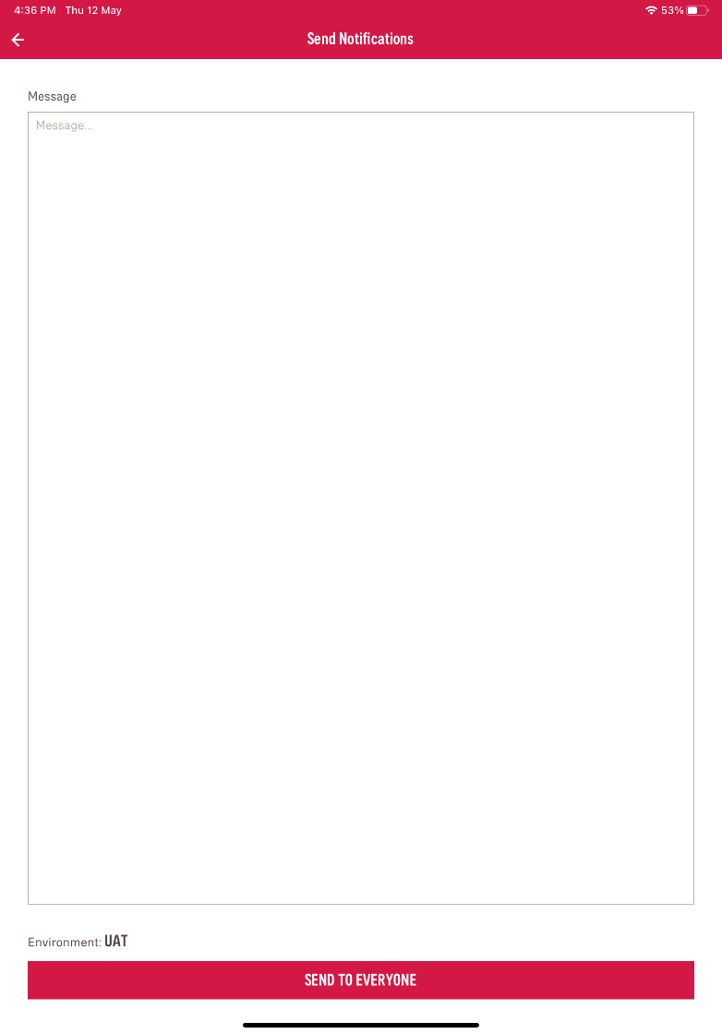
Staff – Send Notifications (Send)

Slide 27

Staff – Send Notifications (Campaigns)

Slide 28
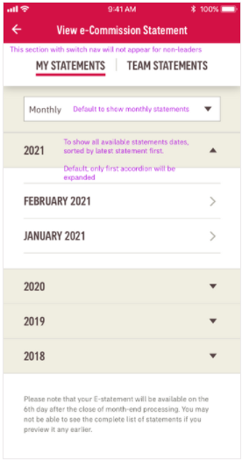
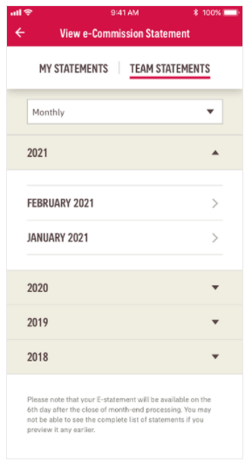
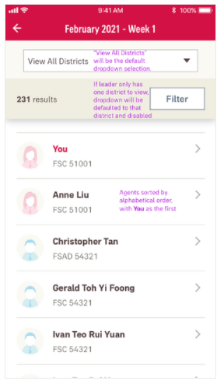
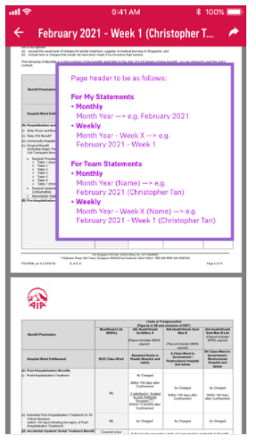
Agent/Staff - View e-Commission Statement
To be replaced with new skin during iSmart+DDS2.0 re-skin launch

Slide 29
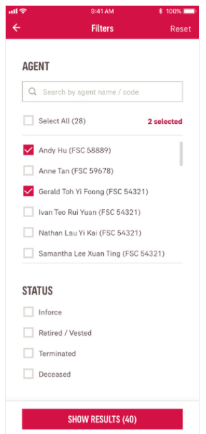
Agent/Staff - View e-Commission Statement - Filter

Slide 30
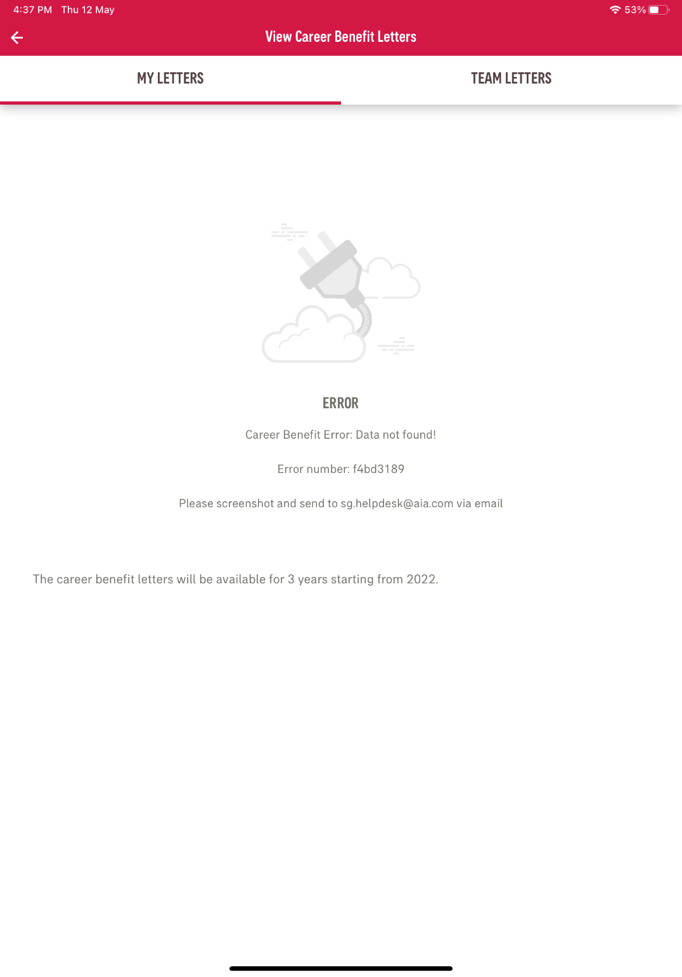

Agent/Staff - View Career Benefit Letters

Slide 31
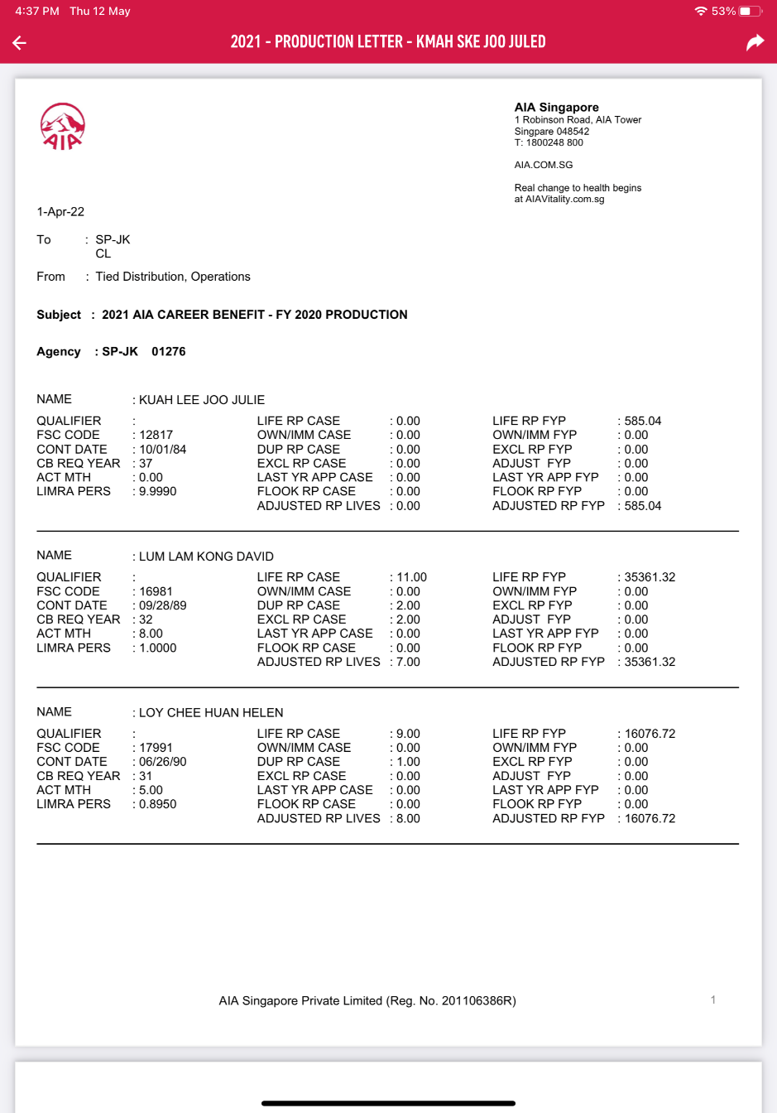
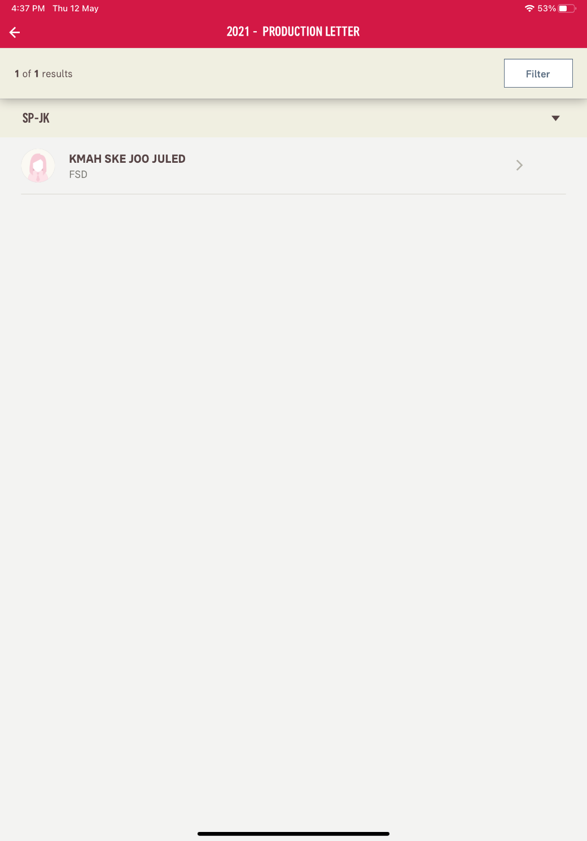
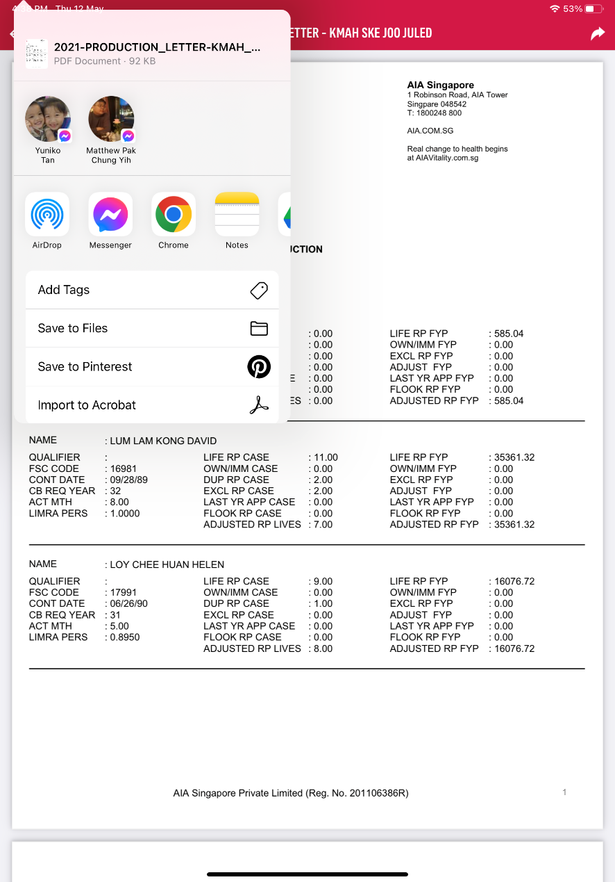
Agent/Staff - View Career Benefit Letters

Slide 32
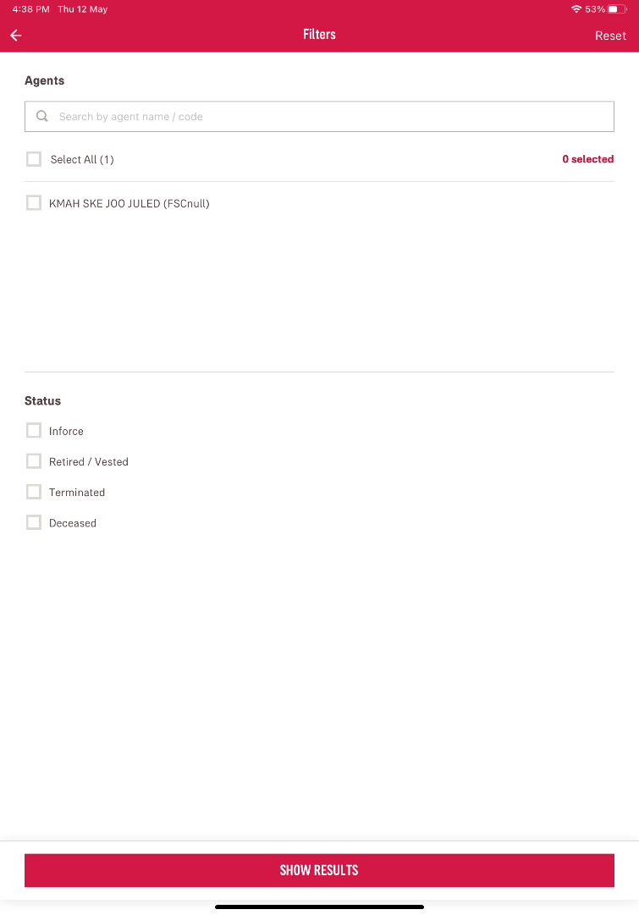
Agent/Staff - View Career Benefit Letters (Filter)

Slide 33
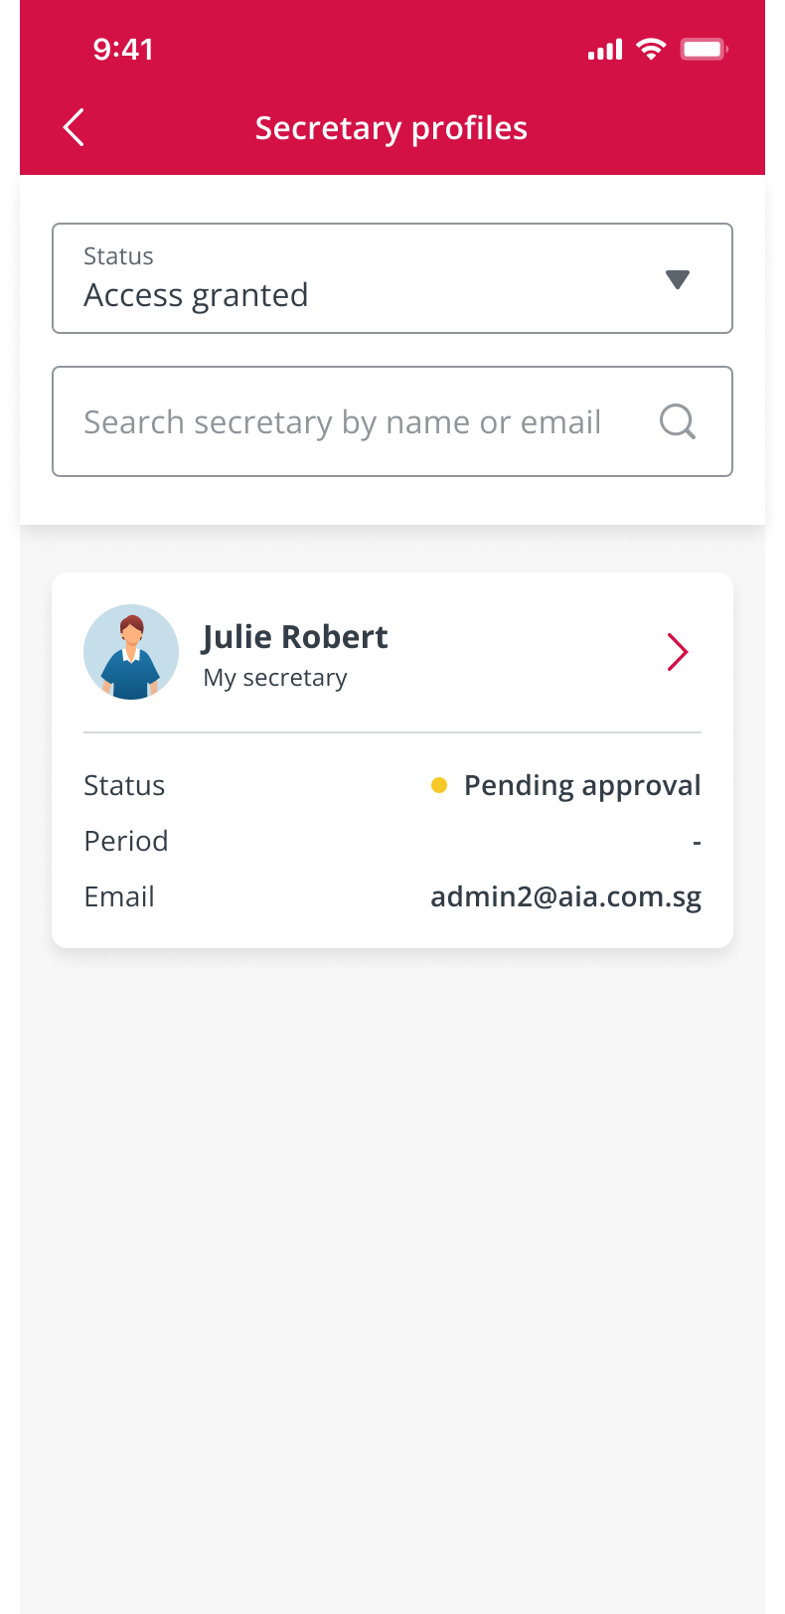
Agent – Secretary Profiles

Slide 34
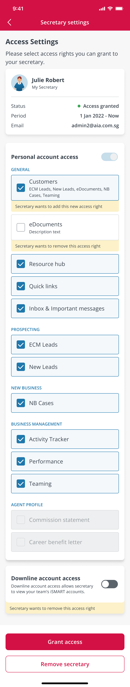
Agent – Secretary Profiles

Slide 35
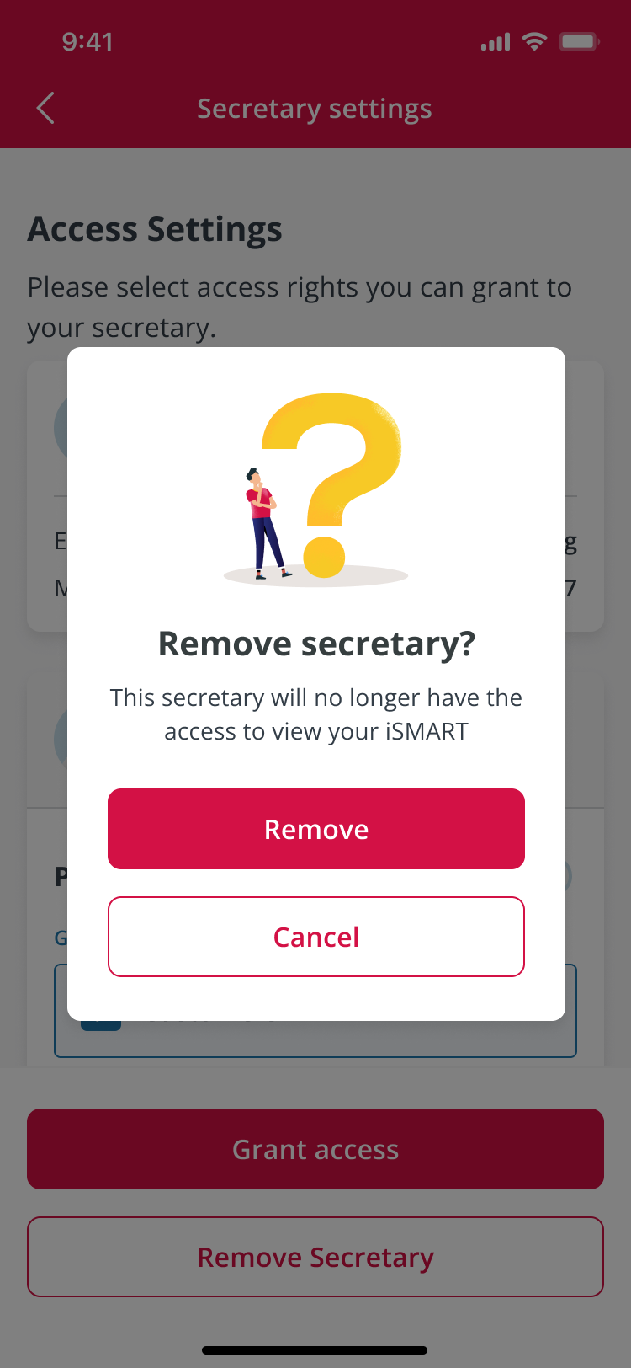
Agent – Remove Secretary

Slide 36

Agent – Access Removed

Slide 37
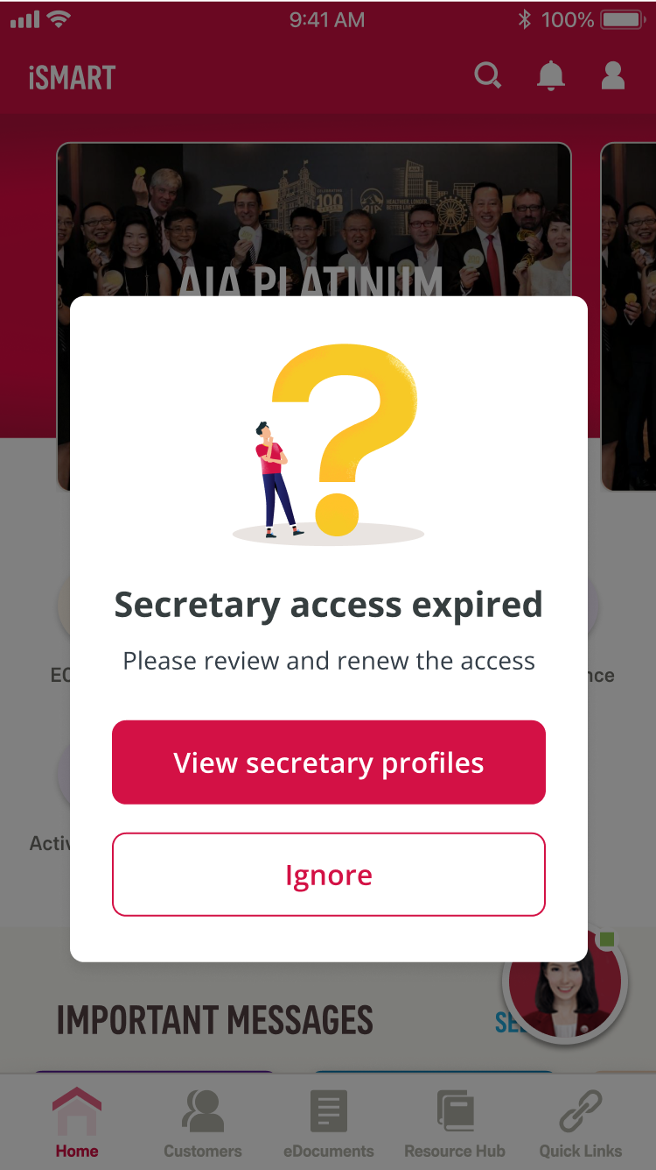
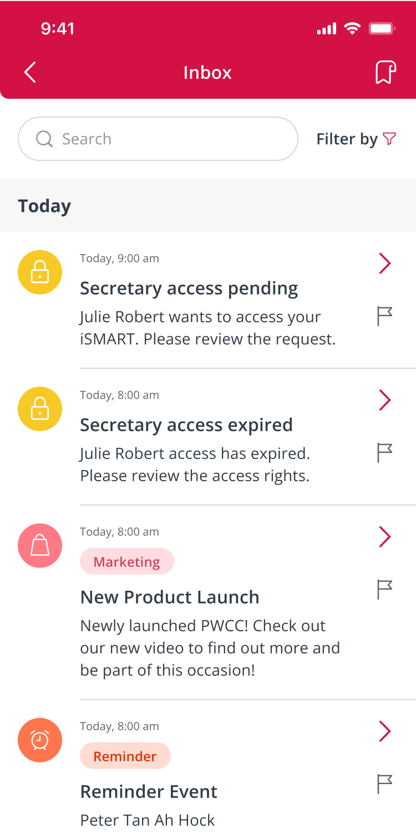
Agent – Secretary Access Expired

Slide 38
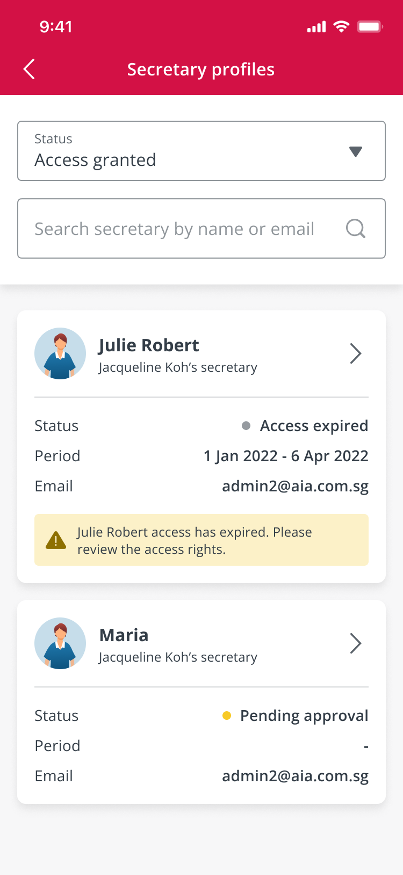
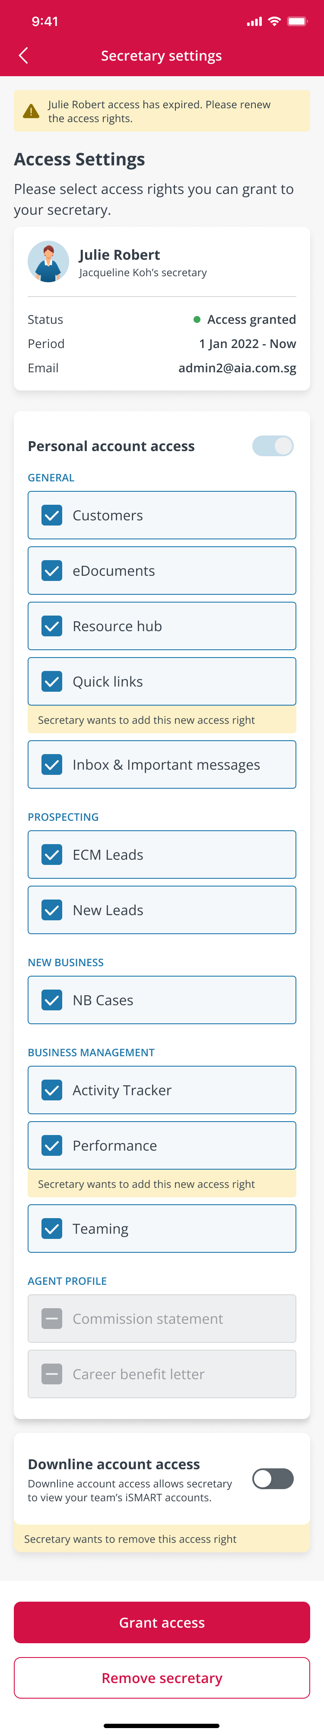

Agent – Access Renewed

Slide 39
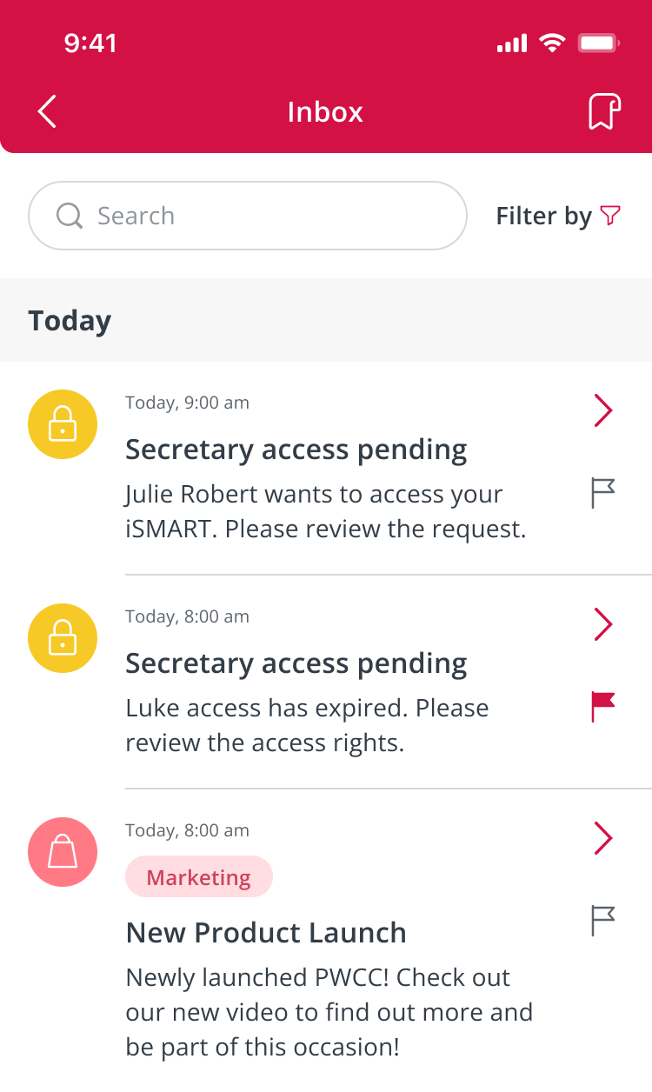

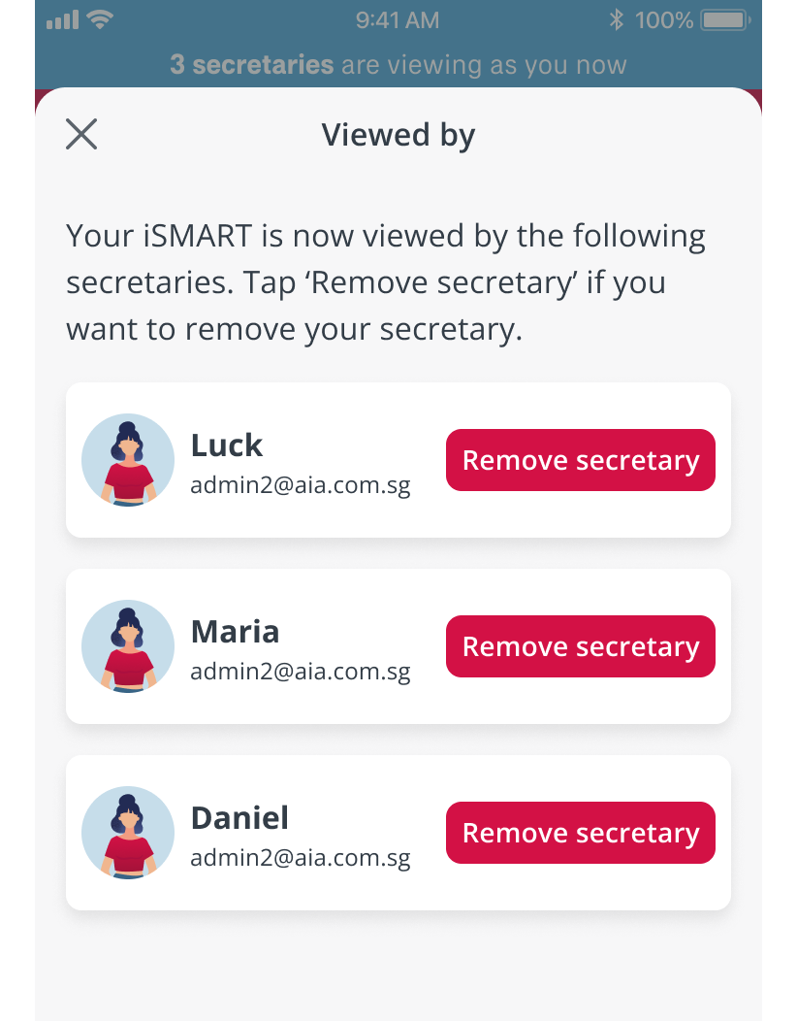
Agent – Viewed By

Slide 40
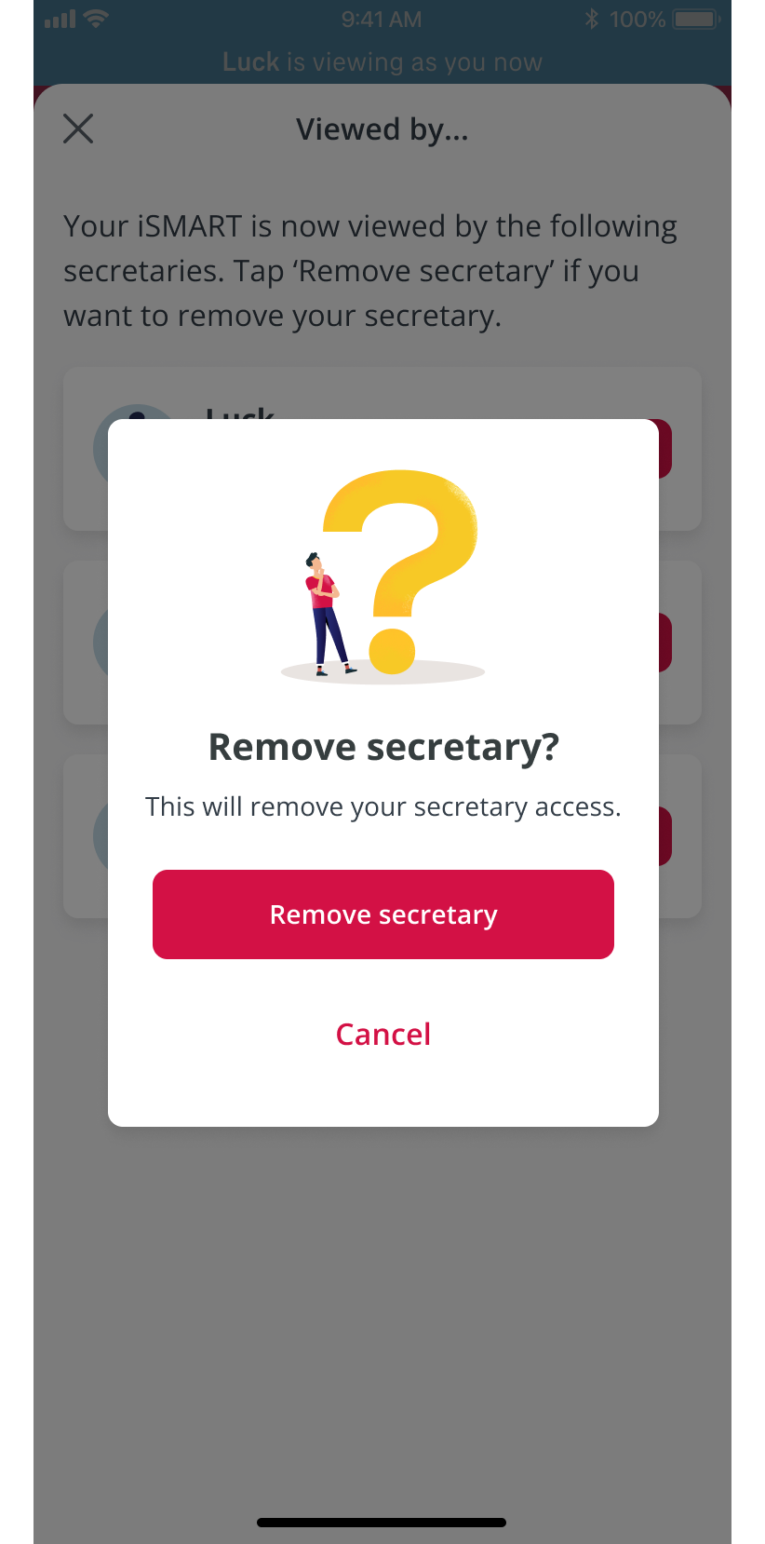
Agent – Remove Secretary

